Slide 1

Run-Walk Across America
Memorial Day to Labor Day
Week 4 Maps
Segment 7: Kooskia ID to Lolo MT
Segment 8: Lolo MT to Missoula MT
Segment 9: Missoula MT to Helena MT

Slide 2
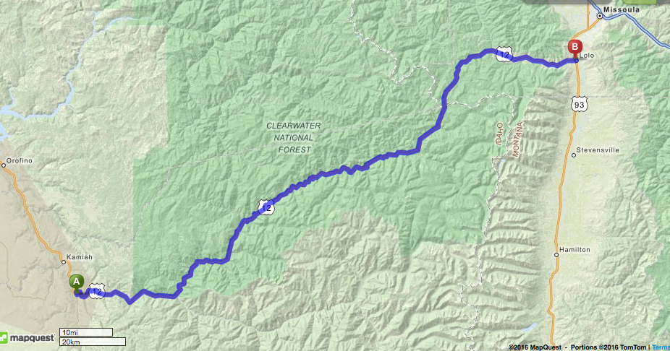
Segment 7:
Kooskia ID to Lolo MT
Lolo MT
Kooskia ID
Copyright MapQuest Classic 2016

Slide 3
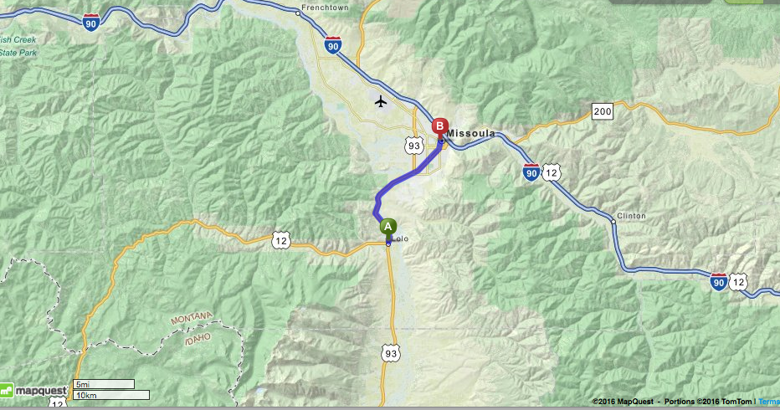
Segment 8:
Lolo MT to Missoula MT
Copyright MapQuest Classic 2016

Slide 4
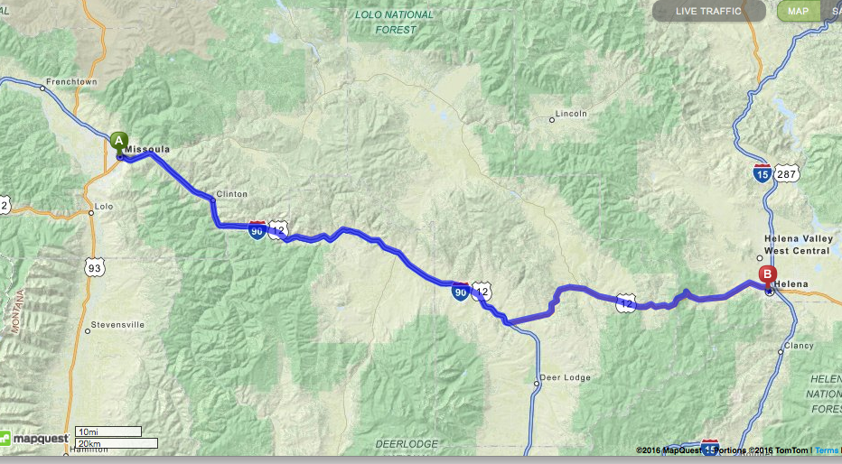
Segment 9:
Missoula MT to Helena MT
Copyright MapQuest Classic 2016

Slide 5
Run-Walk Across America
Memorial Day to Labor Day
Week 5 Maps
Segment 10: Helena MT to Bozeman MT
Segment 11: Bozeman MT to Columbus MT
Segment 12: Columbus MT to Lovell WY

Slide 6
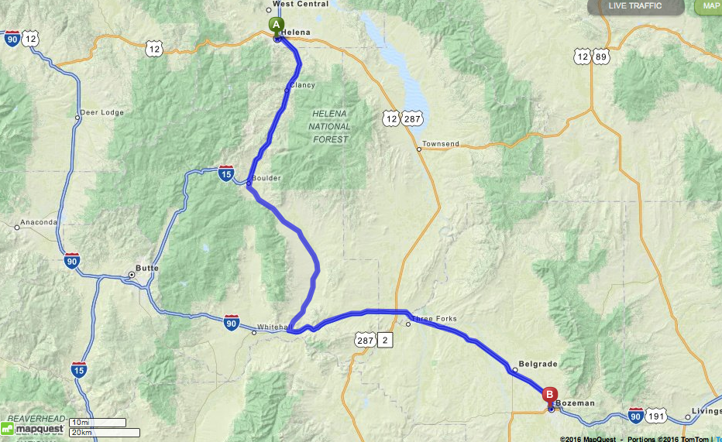
Segment 10:
Helena MT to Bozeman MT
Copyright MapQuest Classic 2016

Slide 7
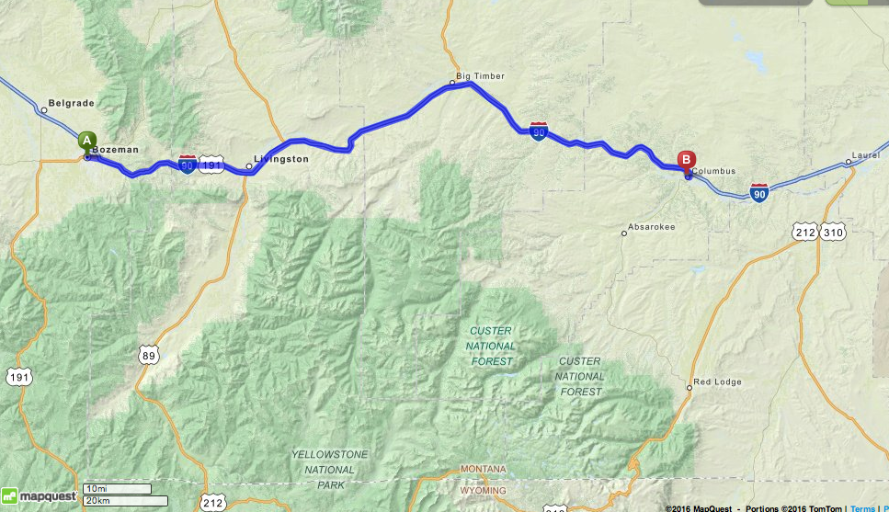
Segment 11:
Bozeman MT to Columbus MT
Copyright MapQuest Classic 2016

Slide 8
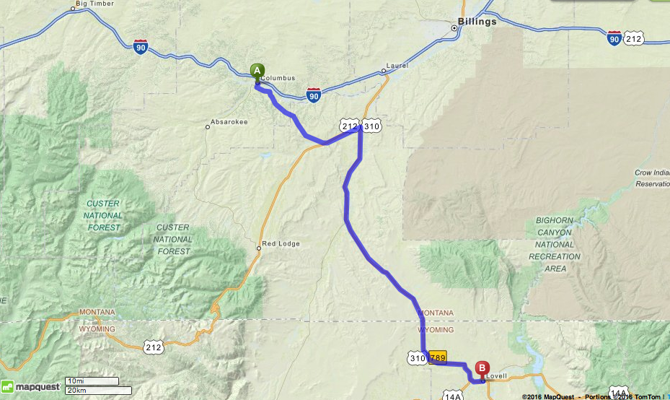
Segment 12:
Columbus MT to Lovell WY
Copyright MapQuest Classic 2016

Slide 9
Run-Walk Across America
Memorial Day to Labor Day
Week 6 Maps
Segment 13: Lovell WY to Sheridan WY
Segment 14: Sheridan WY to Gillette WY

Slide 10
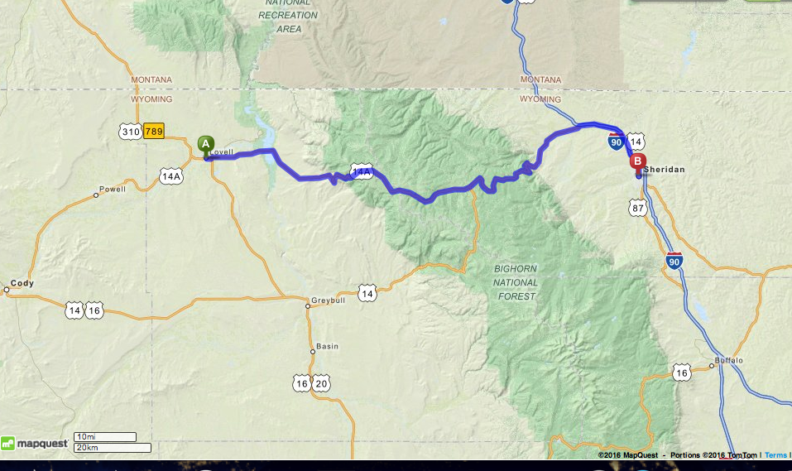
Segment 13:
Lovell WY to Sheridan WY
Copyright MapQuest Classic 2016

Slide 11
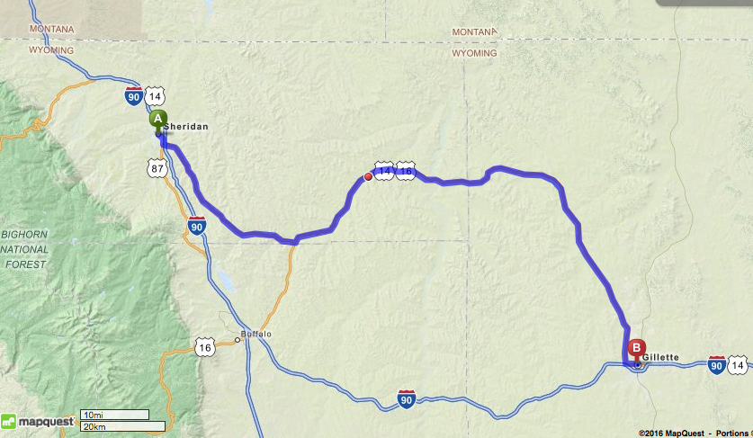
Segment 14:
Sheridan WY to Gillette WY
Copyright MapQuest Classic 2016

