Slide 1

Run-Walk Across America
Memorial Day to Labor Day
Week 1 Maps
Segment 1: Astoria OR to Portland OR
Segment 2 Portland OR to Hood River OR

Slide 2
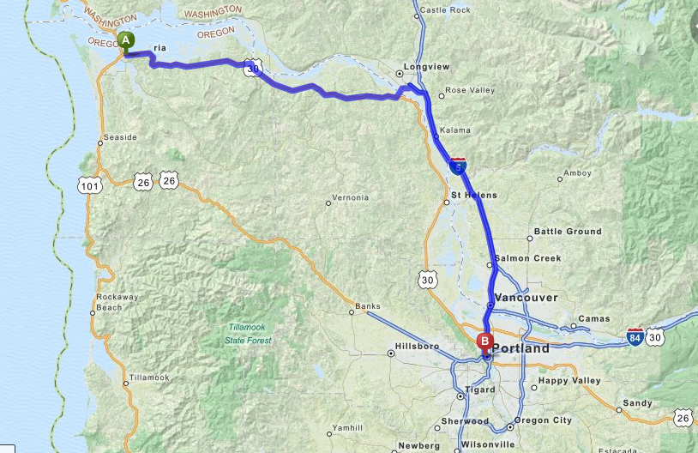
Segment 1:
Astoria OR to Portland OR
Astoria OR
Copyright MapQuest 2016

Slide 3
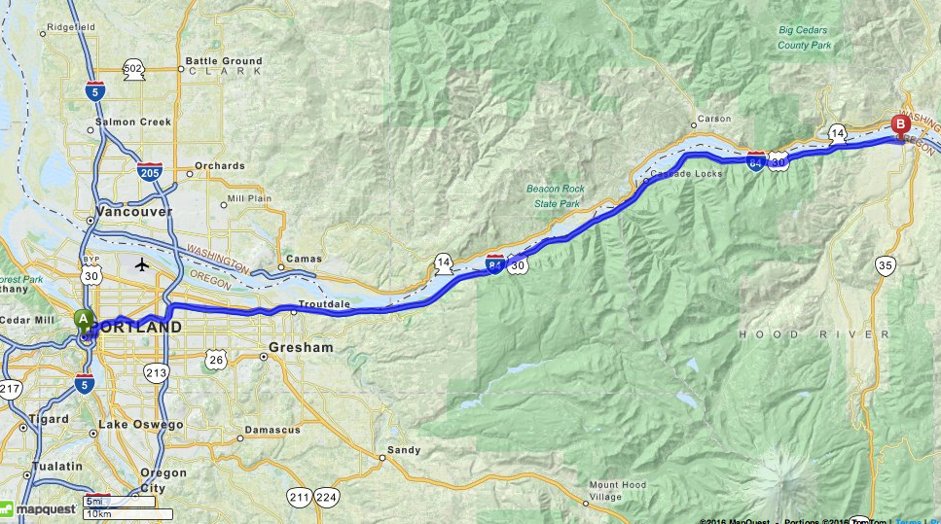
Segment 2:
Portland OR to Hood River OR
Hood River OR
Copyright MapQuest 2016

Slide 4
Run-Walk Across America
Memorial Day to Labor Day
Week 2 Maps
Segment 3:Hood River OR to WA
Segment 4:Prosser WA to Walla Walla WA

Slide 5
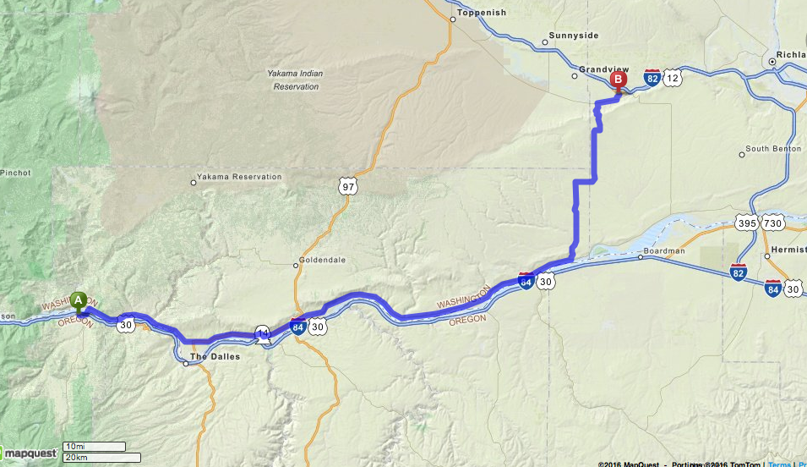
Segment 3:
Hood River OR to Prosser WA
Copyright MapQuest 2016

Slide 6
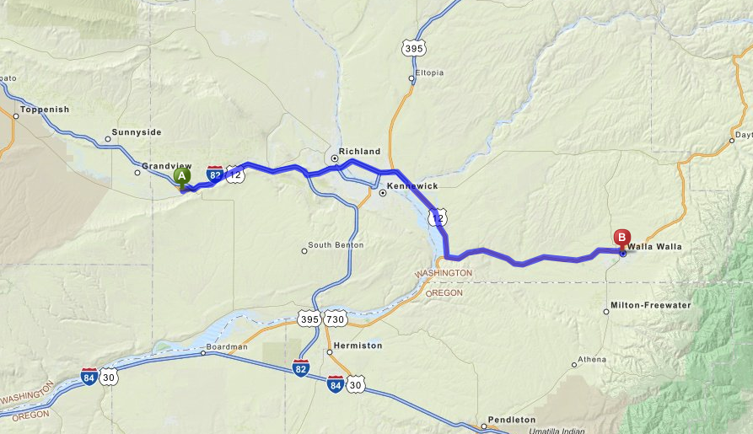
Segment 4:
Prosser WA to Walla Walla WA
Copyright MapQuest 2016

Slide 7
Run-Walk Across America
Memorial Day to Labor Day
Week 3 Maps
Segment 5: Walla Walla WA to Lewiston ID
Segment 6: Lewiston ID to Kooskia ID

Slide 8
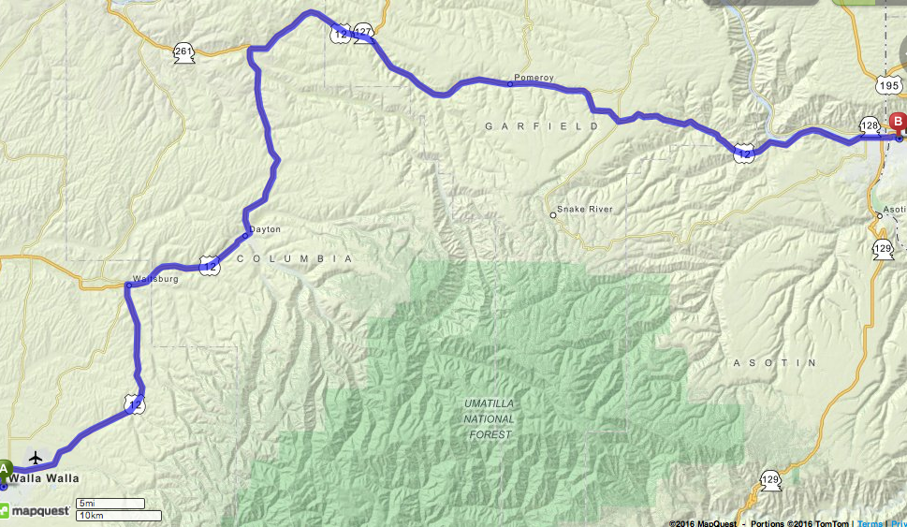
Segment 5:
Walla Walla WA to Lewiston ID
Copyright MapQuest 2016

Slide 9
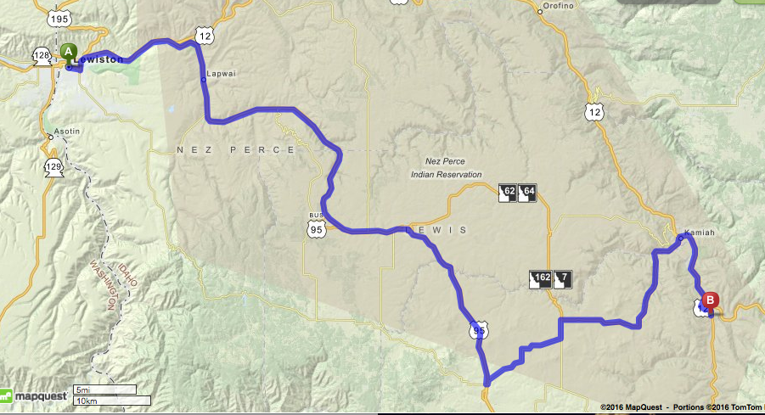
Segment 6
Lewiston ID to Kooskia ID
Lewiston ID
Kooskia ID

